Slide 1

NOIDA INSTITUTE OF ENGINEERING & TECHNOLOGY GREATER NOIDA
B.Tech 4th Year, VII Sem. Entrepreneurship Development & Intellectual Property Rights (AOE0771)
Unit 1
By
Alok Raj
Assistant Professor
MBA Department
NIET, GREATER NOIDA

Slide 2
Index/Content
S. No. | Index
1. | Name of Subject with code, Course and Subject Teacher
2. | Brief Introduction of Faculty member with Photograph
3. | Evaluation Scheme
4. | Syllabus
5. | Branch wise Application
6. | Course Objective(s)
7. | Course Outcome(s)
8. | Program Outcomes (PSOs)
9. | Cos and POs Mapping
Alok Raj AOE0771 Unit 1

Slide 3
Index/Content
S. No. | Index
20. | Lecture related to topic
21. | Daily Quiz
22. | Weekly Assignment
23. | Topic Links
24. | MCQs
25. | Glossary Questions
26. | Old question papers
27. | Expected Questions
28. | Recap of unit
Alok Raj AOE0771 Unit 1

Slide 4
Faculty Introduction
Faculty Name: Mr. Alok Raj
Designation : Assistant Professor
Department : MBA
Qualification :
MBA (Marketing and Operations)
Specialization : Marketing & Operations
Teaching Area: General Management , Operations Management
.Subject: Enterpreneurial Development and Intellectual Property Rights by: Kshitij Chandra

Slide 5

Subject Syllabus
Unit –I
Entrepreneurship: need, scope,
Entrepreneurial competencies & traits,
Factors affecting entrepreneurial development,
Entrepreneurial motivation (Mc Clelland Achievement motivation theory), conceptual model of entrepreneurship,
entrepreneur vs. intrapreneur;
Classification of entrepreneurs; Entrepreneurial Development Programmes.
Subject: Entrepreneurship Development & Intellectual Property Rights By : Alok Raj

Slide 6
Subject Syllabus
Unit –II
Introduction to Innovation,
Entrepreneurial Idea Generation and Identifying Business Opportunities,
Management skills for Entrepreneurs and managing for Value Creation,
Creating and Sustaining Enterprising Model & Organizational Effectiveness,
New initiatives taken by the Government to promote entrepreneurship in India at a larger scale.
Subject: Entrepreneurship Development & Intellectual Property Rights By : Alok Raj
12-Aug-25 VIJAY LAXMI AEO0771

Slide 7
Subject Syllabus
UNIT III
The business plan as an entrepreneurial tool,
Business Planning Process: elements of business planning, preparation of project plan,
Components of an ideal business plan – market plan, financial plan, operational plan, and,
Feasibility Analysis – aspects and methods: Economic, financial, and market analysis - and technological feasibility. Various Forms of business ownership,
Registration of business units; start-up to going IPO; revival, exit and end to a venture.
Subject: Entrepreneurship Development & Intellectual Property Rights By : Alok Raj
12-Aug-25 VIJAY LAXMI AEO0771

Slide 8
Subject Syllabus
UNIT IV
Estimating financial funds requirement; Sources of finance – banks and financial institutions – IFCI, ICICI, IDBI and SIDBI), financing of Small Business Unit. Role of central government and state government in promoting entrepreneurship with various incentives, subsidies, grants, export oriented units – fiscal & tax concessions, other government initiatives and inclusive entrepreneurial growth. Overview of MSME policy of government in India. Role of agencies assisting entrepreneurship
Entrepreneurship Development Institute (EDI). DICs, SSIs, NSICs, EDII NIESBUD, NEDB
New initiatives taken by government to promote entrepreneurship in India at larger scale.
Subject: Entrepreneurship Development & Intellectual Property Rights By : Alok Raj
12-Aug-25 VIJAY LAXMI AEO0771

Slide 9
Subject Syllabus
UNIT V
Introduction to Intellectual Property Right (IPR), intellectual property and its protection, Forms of Protection depending on product; Patent, copyright, trademark, design knowhow, trade secrets etc.
Subject: Entrepreneurship Development & Intellectual Property Rights By : Alok Raj
12-Aug-25 VIJAY LAXMI AEO0771

Slide 10


Noida Institute of Engineering and Technology, Greater Noida
ROLE OF ENTREPRENEURSHIP
Unit:1
Subject Name
Entrepreneurship Development & IPR
Alok Raj
Department of MBA
Course Details B.Tech (BT) 7th Semester
Subject: Entrepreneurship Development & Intellectual Property Rights By : Alok Raj

Slide 11
Content
Concept of Entrepreneurship
Role of Entrepreneurship in Economic Development
Entrepreneurial traits, types, culture and structure
competing theories of Entrepreneurship
Qualities of a successful entrepreneur
Entrepreneurial motivation
Corporate entrepreneurship
Intrapreneurship
Subject: Entrepreneurship Development & Intellectual Property Rights By : Alok Raj
VIJAYLAXMI AOE0771 Unit 1

Slide 12
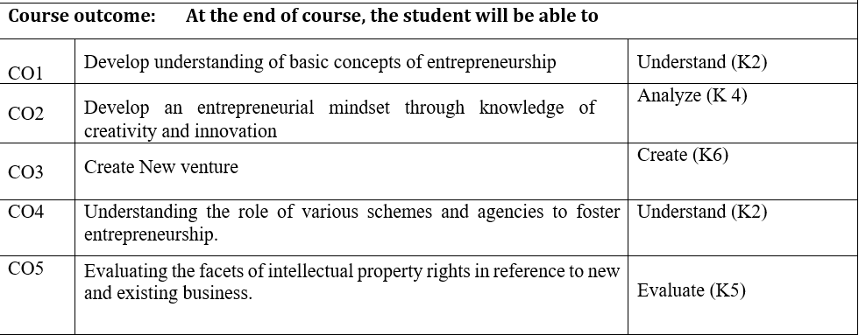
Course Outcome
Subject: Entrepreneurship Development & Intellectual Property Rights By : Alok Raj

Slide 13
Program Educational Outcomes
PEO1: Conceptual Knowledge to adapt in rapidly changing environment and learn new skills and demonstrate application of management principles in professional work setting.
PEO2: Apply appropriate tools for decision making for solving complex managerial problems in local or global context
PEO3: Exhibit Integrity, social responsibility and teamwork
PEO4: Exhibit ethics, communication skills, leadership qualities and entrepreneurial mindset
Subject: Entrepreneurship Development & Intellectual Property Rights By : Alok Raj

Slide 14
Course Objective
Explore the dimensions of creativity, innovation, and entrepreneurship
Understand the various sources of idea generation for startups
Understanding the requirements and methods of launching a new business.
Develop an understanding of various schemes and agencies for assisting and fostering entrepreneurship
Develop an understanding of intellectual property rights.
Subject: Entrepreneurship Development & Intellectual Property Rights By : Alok Raj
12-Aug-25 VIJAY LAXMI AEO0771

Slide 15
Objective of the Unit
Explore the dimensions of creativity, innovation, and entrepreneurship
Subject: Entrepreneurship Development & Intellectual Property Rights By : Alok Raj
12-Aug-25 VIJAY LAXMI AEO0771

Slide 16
Course Objective
Explore the dimensions of creativity, innovation, and entrepreneurship
Develop an understanding of intellectual property rights
Be familiar with the financial support associated with new venture start-ups
Understand the various sources of idea generation and screening
Understand the policy framework for promoting entrepreneurship and providing finance to entrepreneurs.
Subject: Entrepreneurship Development & Intellectual Property Rights By : Alok Raj
12-Aug-25 VIJAY LAXMI AEO0771

Slide 17
Program Outcomes
1. Engineering knowledge: Apply the knowledge of mathematics, science, engineering fundamentals, and an engineering specialization for the solution of complex engineering problems.
2. Problem analysis: Identify, formulate, research literature, and analyse complex engineering problems reaching substantiated conclusions using first principles of mathematics, natural sciences, and engineering sciences.
3. Design/development of solutions: Design solutions for complex engineering problems and design system components or processes that meet the specified needs with appropriate consideration for public health and safety, and cultural, societal, and environmental considerations.
Subject: Entrepreneurship Development & Intellectual Property Rights By : Alok Raj

Slide 18
Program Outcomes
4. Conduct investigations of complex problems: Use research-based knowledge and research methods including design of experiments, analysis and interpretation of data, and synthesis of information to provide valid conclusions.
5. Modern tool usage: Create, select, and apply appropriate techniques, resources, and modern engineering and IT tools, including prediction and modeling to complex engineering activities, with an understanding of the limitations.
6. The engineer and society: Apply reasoning informed by the contextual knowledge to assess societal, health, safety, legal and cultural issues and the consequent responsibilities relevant to the professional engineering practice.
Subject: Entrepreneurship Development & Intellectual Property Rights By : Alok Raj
12-Aug-25 VIJAY LAXMI AEO0771

Slide 19
Program Outcomes
7. Environment and sustainability: Understand the impact of the professional engineering solutions in societal and environmental contexts, and demonstrate the knowledge of, and need for sustainable development.
8. Ethics: Apply ethical principles and commit to professional ethics and responsibilities and norms of the engineering practice.
9. Individual and teamwork: Function effectively as an individual, and as a member or leader in diverse teams, and in multidisciplinary settings.
Subject: Entrepreneurship Development & Intellectual Property Rights By : Alok Raj
12-Aug-25 VIJAY LAXMI AEO0771

Slide 20
Program Outcomes
10. Communication: Communicate effectively on complex engineering activities with the engineering community and with the society at large, such as, being able to comprehend and write effective reports and design documentation, make effective presentations, and give and receive clear instructions.
11. Project management and finance: Demonstrate knowledge and understanding of the engineering and management principles and apply these to one’s own work, as a member and leader in a team, to manage projects and in multidisciplinary environments.
12. Life-long learning:Recognize the need for and have the preparation and ability to engage in independent and life-long learning in the broadest context of technological change.
Subject: Entrepreneurship Development & Intellectual Property Rights By : Alok Raj
12-Aug-25 VIJAY LAXMI AEO0771

Slide 21
Program Educational Outcomes
Program Educational Outcomes
PEO1: Conceptual Knowledge to adapt in rapidly changing environment and learn new skills and demonstrate application of management principles in professional work setting.
PEO2: Apply appropriate tools for decision making for solving complex managerial problems in local or global context
PEO3: Exhibit Integrity, social responsibility and teamwork
PEO4: Exhibit ethics, communication skills, leadership qualities and entrepreneurial mindset
Subject: Entrepreneurship Development & Intellectual Property Rights By : Alok Raj
12-Aug-25 VIJAY LAXMI AEO0771

Slide 22
Course Outcome
Course outcome | At the end of course, the student will be able to
CO1 | Develop understanding of basic concepts of entrepreneurship. | K1,K2
CO2 | Develop an entrepreneurial mindset through knowledge of creativity and innovation | K3,K4
CO3 | Evaluating and understanding a holistic approach of launching a new business venture | K4
CO4 | Understanding of converting an Idea to an opportunity and various funding sources | K2
CO5 | Develop knowledge on Entrepreneurial Finance, Assistance and role of Entrepreneurial Development Agencies | K4, K5
Subject: Entrepreneurship Development & Intellectual Property Rights By : Alok Raj
12-Aug-25 VIJAY LAXMI AEO0771

Slide 23
CO-PO and PSO Mapping
Sr. No | Course Outcome | PO1 | PO2 | PO3 | PO4 | PO5
1 | CO 1 | H | H | M
2 | CO 2 | M |  |  | H
3 | CO 3 | H | M |  |  | M
4 | CO 4 | H |  |  |  | H
5 | CO 5 | H |  | H |  | M
Program Specific Outcomes | Course Outcomes
 | 1 | 2 | 3 | 4 | 5
1 | M | H | H | H | H
2 |  | M |  | H
3 | H | M | M | M
4 | H | H |  | M | M
Subject: Entrepreneurship Development & Intellectual Property Rights By : Alok Raj
12-Aug-25 VIJAY LAXMI AEO0771

Slide 24
Topic Mapping with CO
Topic | Mapping With CO
Concept of Entrepreneurship | CO1
Role of Entrepreneurship in Economic Development | CO1
Entrepreneurial traits, types, culture and structure | CO1
competing theories of Entrepreneurship | CO1
Qualities of a successful entrepreneur | CO2
Entrepreneurial motivation | CO1
Corporate entrepreneurship | CO2
Intrapreneurship | CO1
Subject: Entrepreneurship Development & Intellectual Property Rights By : Alok Raj
12-Aug-25 VIJAY LAXMI AEO0771

Slide 25
Objective of Topic
Enables the students with basic understanding of the concepts of entrepreneurship so that it is easy to them to practice them and apply in real life.
Subject: Entrepreneurship Development & Intellectual Property Rights By : Alok Raj
12-Aug-25 VIJAY LAXMI AEO0771

Slide 26

Prerequisite and Recap
Subject: Entrepreneurship Development & Intellectual Property Rights By : Alok Raj
12-Aug-25 VIJAY LAXMI AEO0771

Slide 27






ABOUT ENTREPRENEURSHIP…
ENTREPRENEUR
PERSON
ENTREPRENEURSHIP
PROCESS
ENTERPRISE
OBJECT
Subject: Entrepreneurship Development & Intellectual Property Rights By : Alok Raj
12-Aug-25 VIJAY LAXMI AEO0771

Slide 28

ENTREPRENEUR
ENTREPRENEUR
The word entrepreneur is derived from the French verb “enterprendre”, which means “to undertake”.
Entrepreneur is the person who brings together the factors of production and combines them into a product.
He organizes and manages a business unit assuming the risk for profit.
An entrepreneur is a creator or a designer who designs new ideas and business processes according to the market requirements and his/her own passion. To be a successful entrepreneur, it is very important to have managerial skill and strong team building abilities.
Subject: Entrepreneurship Development & Intellectual Property Rights By : Alok Raj
12-Aug-25 VIJAY LAXMI AEO0771

Slide 29
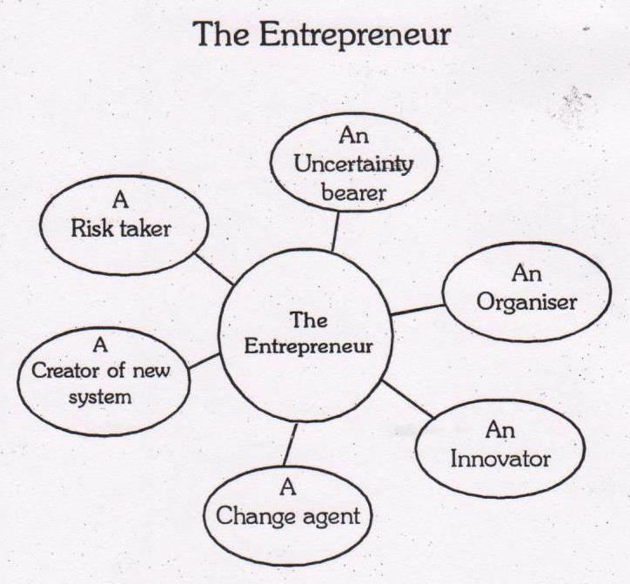
ENTREPRENEUR
ENTREPRENEUR
Subject: Entrepreneurship Development & Intellectual Property Rights By : Alok Raj
12-Aug-25 VIJAY LAXMI AEO0771

Slide 30
6Cs that motivate entrepreneurs
The 6Cs that motivate entrepreneurs to establish their own business:
Change − Entrepreneurs frequently want change, not only change, they also want to be the bearers of change.
Challenge − Some people love challenges and they opt for starting a new business as it is very challenging to handle big problems. These people find typical job in a big corporate as boring and not challenging enough.
Creativity − Running one’s own business is all about being more creative and having the independence to make new discoveries. For example, testing a new website design, launching a new marketing scheme, creating inventive items that solve a known issue in a different way, creating new advertising campaigns, etc.
Subject: Entrepreneurship Development & Intellectual Property Rights By : Alok Raj
12-Aug-25 VIJAY LAXMI AEO0771

Slide 31
6Cs that motivate entrepreneurs
6Cs that motivate entrepreneurs
Control − They want to be their own boss having their own time, own pace, location of their choice, employees of their choice and have a progressive role in deciding the direction of the company.
Curiosity − Successful entrepreneurs are always anxious and ask − "what if we do X this way?”
Cash − The last but not the least part is the cash. Money says it all. Many non-entrepreneurs have a misconception that cash comes first for entrepreneurs but this is never really true.
It can be said that the highest motivating factor is the urge to get something or the drive to do something differently.
Subject: Entrepreneurship Development & Intellectual Property Rights By : Alok Raj
12-Aug-25 VIJAY LAXMI AEO0771

Slide 32
ETREPRENEURSHIP
ENTREPRENEURSHIP
Entrepreneurship is the process of creating value by bringing together a unique package of resources to exploit an opportunity.
Entrepreneurship is the art of starting a business, basically a startup company offering creative product, process or service.
An entrepreneur is an innovator or a creator who introduces something new to the firm or economy. It can be a new method of production, a new product, a new source of material, a new market or any other similar innovation
Subject: Entrepreneurship Development & Intellectual Property Rights By : Alok Raj
12-Aug-25 VIJAY LAXMI AEO0771

Slide 33
DEFINITION
According to A. H. Cole, “Entrepreneurship is the purposeful activities of an individual or a group of associated individuals undertaken to initiate, maintain or organize a profit oriented business unit for the production or distribution of economic goods and services”.
Subject: Entrepreneurship Development & Intellectual Property Rights By : Alok Raj
12-Aug-25 VIJAY LAXMI AEO0771

Slide 34
ENTREPRENEURSHIP
In contemporary markets, entrepreneur act as:
innovators or developers who identify and capture opportunities
transform the opportunities into merchandisable concepts
create value through multiple stakeholders and resources
take risks whilst seeking rewards for their ventures and efforts
Subject: Entrepreneurship Development & Intellectual Property Rights By : Alok Raj
12-Aug-25 VIJAY LAXMI AEO0771

Slide 35
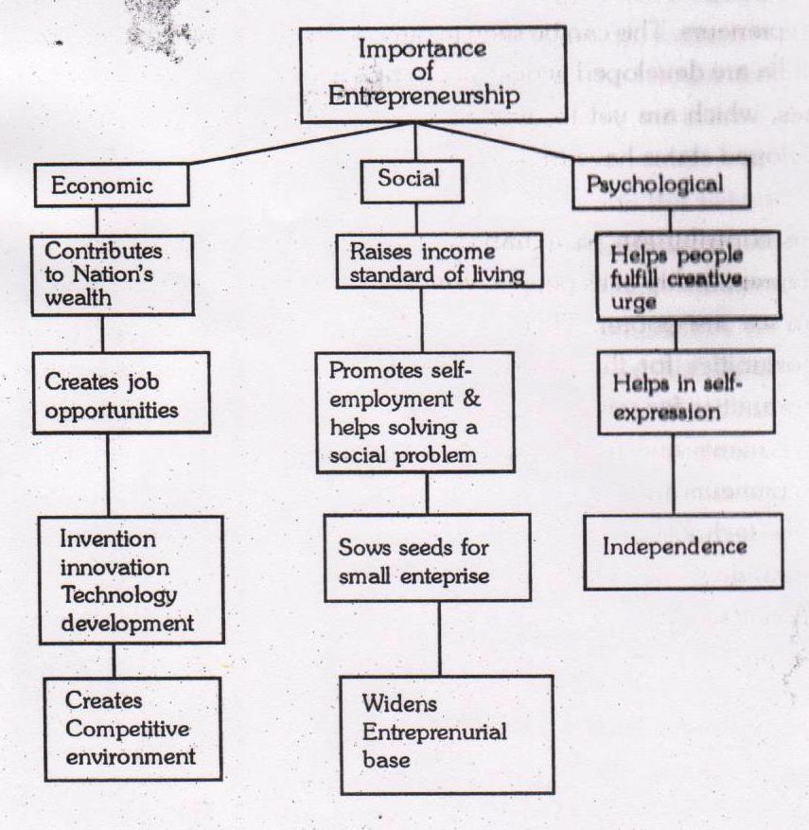
Importance of Entrepreneurship
Subject: Entrepreneurship Development & Intellectual Property Rights By : Alok Raj
12-Aug-25 VIJAY LAXMI AEO0771

Slide 36
Role of Entrepreneurship in Economic Development
In the modern day markets, the term entrepreneur has been closely linked with economic development.
An economic development can emerge due to several reasons, which includes:
(a) the launch of new source of procurement for raw materials or materials
(b) the introduction of a new production mechanism
(c) the introduction of a new quality of product, or a novel product
(d) the opening of new market
(e) the re-organisation of a business.
The management of all these aspects are carried by an enterprise, and the people whose functions are to carry out these activities are called entrepreneurs (Bull & Willard, 1993)
Subject: Entrepreneurship Development & Intellectual Property Rights By : Alok Raj
12-Aug-25 VIJAY LAXMI AEO0771

Slide 37
Role of entrepreneurship in Economic Development
Rate of economic progress of the country depends upon the rate of innovations which in-turn depend upon the distribution of entrepreneurial talent of the population.
Entrepreneur initiate and sustain the process of economic development in the following ways:
Capital formation
Improvement in per capita income
Generation of employment
Balanced regional development
Improvement in living standards
Subject: Entrepreneurship Development & Intellectual Property Rights By : Alok Raj
12-Aug-25 VIJAY LAXMI AEO0771

Slide 38
Role of entrepreneurship in Economic Development
5. Economic independence
6. Backward and forward linkages
7. Harnessing the locally available resources
8. Balanced regional growth.
9. Reducing unrest and social tension among youth
10. Bring innovations in enterprises
Subject: Entrepreneurship Development & Intellectual Property Rights By : Alok Raj
12-Aug-25 VIJAY LAXMI AEO0771

Slide 39
Entrepreneurial Traits
Vision
Motivation
Risk Bearer
Leader
Goal Oriented
Hardworking
Willing To Take Initiative
Strong Sense Of Commitment
Subject: Entrepreneurship Development & Intellectual Property Rights By : Alok Raj
12-Aug-25 VIJAY LAXMI AEO0771

Slide 40
Recap and Quiz
Explain the role of an entrepreneur in economic development.
Define entrepreneurship.
Who is an entrepreneur?
Define the qualities of an entrepreneur.
Subject: Entrepreneurship Development & Intellectual Property Rights By : Alok Raj
12-Aug-25 VIJAY LAXMI AEO0771

Slide 41
Noida Institute of Engineering and Technology, Greater Noida
ROLE OF ENTREPRENEURSHIP
Subject Name
Entrepreneurship Development & IPR
Subject: Entrepreneurship Development & Intellectual Property Rights By : Alok Raj
12-Aug-25 VIJAY LAXMI AEO0771

Slide 42
Precap
Who is an entrepreneur.
Role of an entrepreneur in economic development
Qualities of an entrepreneur.
Subject: Entrepreneurship Development & Intellectual Property Rights By : Alok Raj
12-Aug-25 VIJAY LAXMI AEO0771

Slide 43
Session objective (CO1)
To understand about the various types of entrepreneurs on various bases
To understand the classification of entrepreneurs
The Entrepreneurial Decision Process
Subject: Entrepreneurship Development & Intellectual Property Rights By : Alok Raj
12-Aug-25 VIJAY LAXMI AEO0771

Slide 44
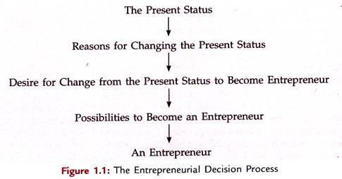
The Entrepreneurial Decision Process
Subject: Entrepreneurship Development & Intellectual Property Rights By : Alok Raj
12-Aug-25 VIJAY LAXMI AEO0771
Notes:
https://studiousguy.com/entrepreneurship-and-entrepreneurial-traits/

Slide 45
The Entrepreneurial culture
Defined by Wickham, the word entrepreneurial is given to describe how the entrepreneur undertakes what they do, a particular style of what entrepreneurs do.
In other hand, Brownson (2013) mentions the term culture that is defined as the attributes, values, beliefs, and behavior in which on the individual learns or acquires from one generation to another, and passed through one person and group to another.
Subject: Entrepreneurship Development & Intellectual Property Rights By : Alok Raj
12-Aug-25 VIJAY LAXMI AEO0771

Slide 46
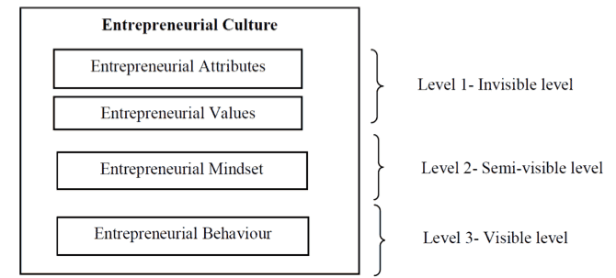
The Entrepreneurial culture
Subject: Entrepreneurship Development & Intellectual Property Rights By : Alok Raj
12-Aug-25 VIJAY LAXMI AEO0771
Notes:
https://barrazacarlos.com/what-is-entrepreneurial-culture/

Slide 47
The Entrepreneurial culture
Two constituents of the unconscious and invisible level are the attributes and the values.
The entrepreneurial attributes are key natural and nurtured indicators that show people who can be turned into an entrepreneur. This set of characteristics have been recognized to be a driver to understand and foster entrepreneurship.
the entrepreneur has to be also nurtured with the appropriate training and experience to encourage their entrepreneurial attributes.
For entrepreneurs the values not only show what will be the decisions that they will make, but also they show how they will approach a new venture.
the values that are associated with entrepreneurship are autonomy, the freedom to act independently, innovativeness, freedom of experimentation, risk taking, ability to take initiatives and competitive aggressiveness.
Subject: Entrepreneurship Development & Intellectual Property Rights By : Alok Raj
12-Aug-25 VIJAY LAXMI AEO0771

Slide 48
Entrepreneurial mindset
On the second level of semi-visible or semi-conscious, here is the entrepreneurial mindset.
The entrepreneurial mindset is the attitude an entrepreneur responds to a certain object in a favorable or unfavorable manner based on a learned predisposition.
Subject: Entrepreneurship Development & Intellectual Property Rights By : Alok Raj
12-Aug-25 VIJAY LAXMI AEO0771

Slide 49
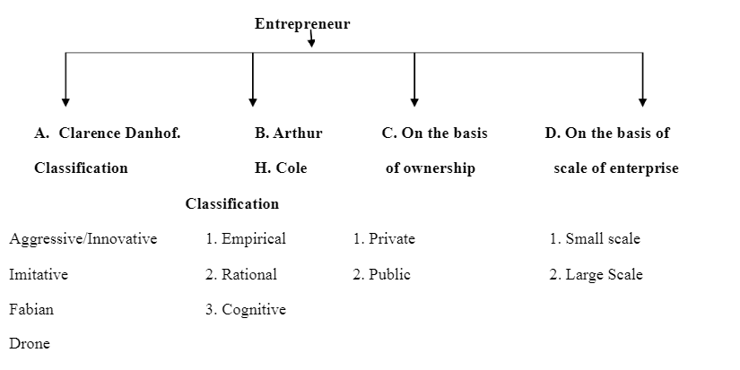
Classification of Entrepreneurs
Subject: Entrepreneurship Development & Intellectual Property Rights By : Alok Raj
12-Aug-25 VIJAY LAXMI AEO0771

Slide 50
CLASSIFICATION BY CLARENCE DANHOF:
Clarence Danhof, classified entrepreneurs in the following categories:
INNOVATIVE ENTREPRENEURS
ADOPTIVE OR IMITATIVE ENTREPRENEURS
FABIAN ENTREPRENEURS
DRONE ENTREPRENEURS
Subject: Entrepreneurship Development & Intellectual Property Rights By : Alok Raj
12-Aug-25 VIJAY LAXMI AEO0771

Slide 51
INNOVATIVE ENTREPRENEURS
They are generally aggressive on experimentation and cleverly
put attractive possibilities into practice.
An innovative entrepreneur, introduces new goods, inaugurates new methods of production, discovers new markets and reorganizes the enterprise.
Innovative entrepreneurs bring about a transformation in
lifestyle and are always interested in introducing innovations.
An innovative entrepreneur sees the opportunity for introducing a new technology, a new product or a new market.
Subject: Entrepreneurship Development & Intellectual Property Rights By : Alok Raj
12-Aug-25 VIJAY LAXMI AEO0771

Slide 52
ADOPTIVE OR IMITATIVE ENTREPRENEURS
Imitative entrepreneurs do not innovate the changes themselves, they only imitate techniques and technology innovated by others. They copy and learn from the innovating entrepreneurs. While innovating entrepreneurs are creative, imitative entrepreneurs are adoptive.
These entrepreneurs face lesser risks and uncertainty then innovative entrepreneurs.
Imitative entrepreneurs are most suitable for the developing regions because in such countries people prefer to imitate the technology, knowledge and skill already available in more advanced countries.
Subject: Entrepreneurship Development & Intellectual Property Rights By : Alok Raj
12-Aug-25 VIJAY LAXMI AEO0771

Slide 53
FABIAN ENTREPRENEURS
FABIAN ENTREPRENEURS
These entrepreneurs are traditionally bounded.
They would be cautious.
They neither introduce new changes nor adopt new methods innovated by others entrepreneurs. They are very much skeptical in their approach in adopting or innovating new technology in their enterprise and they love to remain in the existing business with the age-old techniques of production.
They are shy and lazy. They try to follow the footsteps of their predecessors.
They follow old customs, traditions, sentiments etc. They take up new projects only when it is necessary to do so.
Subject: Entrepreneurship Development & Intellectual Property Rights By : Alok Raj
12-Aug-25 VIJAY LAXMI AEO0771

Slide 54
DRONE ENTREPRENEURS
DRONE ENTREPRENEURS
Drone entrepreneurs are those who refuse to adopt and use opportunities to make changes in production.
They would not change the method of production already introduced.
They follow the traditional method of production.
They may even suffer losses but they are not ready to make changes in their existing production methods.
Subject: Entrepreneurship Development & Intellectual Property Rights By : Alok Raj
VIJAYLAXMI AOE0771 Unit 1

Slide 55
COLE’S CLASSIFICATION
COLE’S CLASSIFICATION
EMPIRICAL ENTREPRENEUR
Who never introduces anything new in his method of production or business.
Simply follows the rule of thumb
Like drone entrepreneurs
2. RATIONAL ENTREPRENEUR
Who is ready to introduce even revolutionary changes on the basis of general economic conditions prevailing in that area.
Takes rational decisions himself depending up on the situation.
3. COGNITIVE ENTREPRENEUR
Who takes advices and services of experts and introduces changes.
Subject: Entrepreneurship Development & Intellectual Property Rights By : Alok Raj
Menka Sharma AOE0771 Unit 1

Slide 56
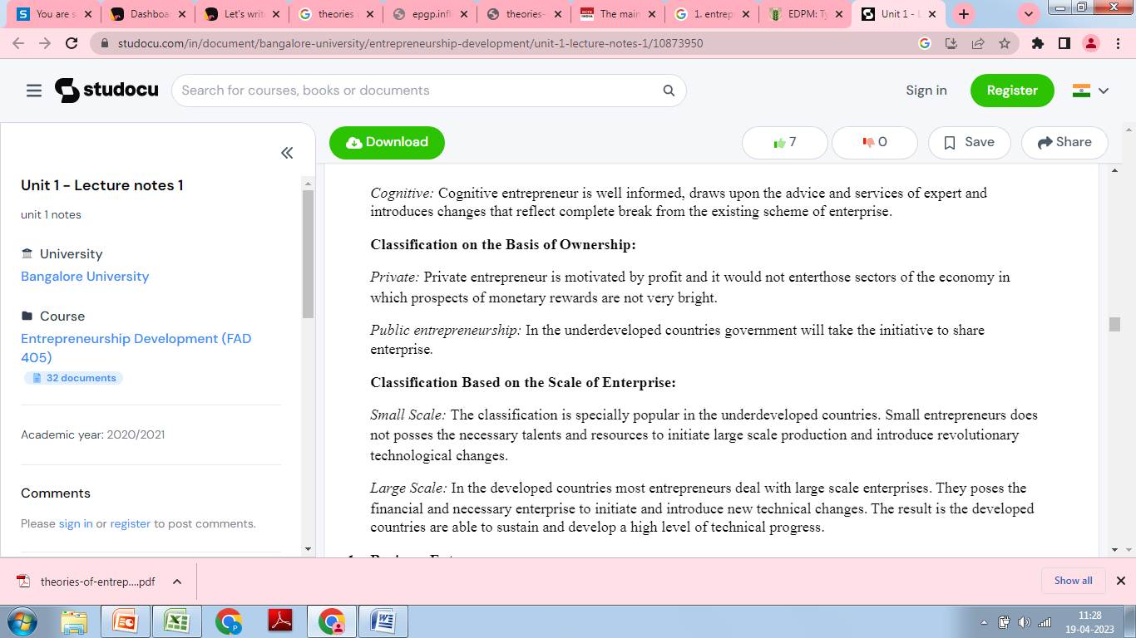
COLE’S CLASSIFICATION
Subject: Entrepreneurship Development & Intellectual Property Rights By : Alok Raj
Menka Sharma AOE0771 Unit 1

Slide 57
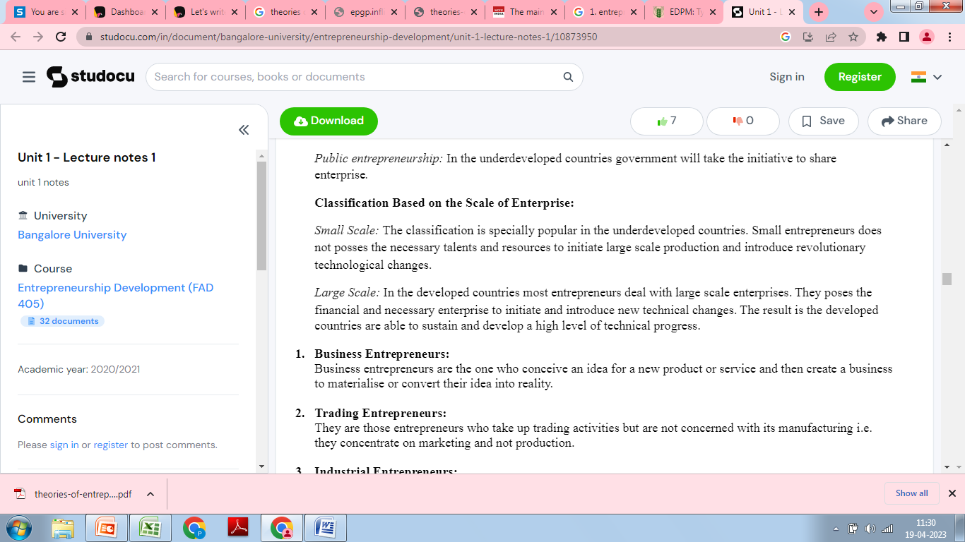
Classification on the basis on Scale of Enterprise
Subject: Entrepreneurship Development & Intellectual Property Rights By : Alok Raj
Menka Sharma AOE0771 Unit 1

Slide 58
ON THE BASIS OF STAGES OF DEVELOPMENT
First Generation Entrepreneur: He is one who starts an industrial unit by means of his own innovative ideas and skills. He is essentially an innovator. He is also called new entrepreneur.
Modern Entrepreneur: He is an entrepreneur who undertakes those ventures which suit the modern marketing needs.
Classical Entrepreneur: He is one who develops a self supporting venture for the satisfaction of customers’ needs. He is a stereo type or traditional entrepreneur.
Subject: Entrepreneurship Development & Intellectual Property Rights By : Alok Raj
Menka Sharma AOE0771 Unit 1

Slide 59
ON THE BASIS OF TYPE OF BUSINESS
ON THE BASIS OF TYPE OF BUSINESS
Business Entrepreneur: He is an individual who discovers an idea to start
a business and then builds a business to convert idea into merchandisable good or service.
Trading Entrepreneur: He is an entrepreneur who undertakes trading activity i.e; buying and selling manufactured goods.
Industrial Entrepreneur: He is an entrepreneur who undertakes
manufacturing activities.
Corporate Entrepreneur: He is a person who demonstrates his innovative
skill in organizing and managing a corporate undertaking.
Agricultural Entrepreneur: They are entrepreneurs who undertake agricultural activities such as raising and marketing of crops, fertilizers and other inputs of agriculture. They are called agripreneurs.
Subject: Entrepreneurship Development & Intellectual Property Rights By : Alok Raj
Menka Sharma AOE0771 Unit 1

Slide 60
ON THE BASIS OF USE OF TECHNOLOGY
Technical Entrepreneur:
They are extremely task oriented.
They are of craftsman type.
They develop new and improved quality goods because of their craftmanship.
They concentrate more on production than on
marketing.
Subject: Entrepreneurship Development & Intellectual Property Rights By : Alok Raj
Menka Sharma AOE0771 Unit 1

Slide 61
ON THE BASIS OF USE OF TECHNOLOGY
ON THE BASIS OF USE OF TECHNOLOGY
Non-Technical Entrepreneur:
These entrepreneurs are not concerned with the technical aspects of the product.
They develop marketing techniques and distribution strategies to promote their business.
Thus they concentrate more on marketing aspects.
Subject: Entrepreneurship Development & Intellectual Property Rights By : Alok Raj
VIJAYLAXMI AOE0771 Unit 1

Slide 62
Professional Entrepreneur
Professional Entrepreneur
Professional Entrepreneur:
He is an entrepreneur who starts a business unit but does not carry on the business for long period.
He sells out the running business and starts another venture.
Subject: Entrepreneurship Development & Intellectual Property Rights By : Alok Raj
VIJAYLAXMI AOE0771 Unit 1

Slide 63
ON THE BASIS OF MOTIVATION
ON THE BASIS OF MOTIVATION
Pure Entrepreneur:
They believe in their own performance while undertaking business activities.
They undertake business ventures for their personal satisfaction, status and ego.
They are guided by the motive of profit.
For example, Dhirubhai Ambani of Reliance Group.
Subject: Entrepreneurship Development & Intellectual Property Rights By : Alok Raj
VIJAYLAXMI AOE0771 Unit 1

Slide 64
ON THE BASIS OF MOTIVATION
ON THE BASIS OF MOTIVATION
Induced Entrepreneur:
He is induced to take up an entrepreneurial activity with a view to avail some benefits from the government.
These benefits are in the form of assistance, incentives, subsidies, concessions and infrastructures.
Subject: Entrepreneurship Development & Intellectual Property Rights By : Alok Raj
Menka Sharma AOE0771 Unit 1

Slide 65
ON THE BASIS OF MOTIVATION
ON THE BASIS OF MOTIVATION
Motivated Entrepreneur:
These entrepreneurs are motivated by the desire to make use of their technical and professional expertise and skills.
They are motivated by the desire for self- fulfillment.
Spontaneous Entrepreneur:
They are motivated by their desire for self- employment and to achieve or prove their excellence in job performance.
They are natural entrepreneurs.
Subject: Entrepreneurship Development & Intellectual Property Rights By : Alok Raj
VIJAYLAXMI AOE0771 Unit 1

Slide 66
ON THE BASIS OF ENTREPRENEURIAL ACTIVITY
ON THE BASIS OF ENTREPRENEURIAL ACTIVITY
Novice: A novice is someone who has started his/her first entrepreneurial venture.
Serial Entrepreneur: A serial entrepreneur is someone who is devoted to one venture at a time but ultimately starts many. He repeatedly starts businesses and grows them to a sustainable size and then sells them off.
Portfolio Entrepreneurs: A portfolio entrepreneur starts and runs a number of businesses at the same time. It may be a strategy of spreading risk or it may be that the entrepreneur is simultaneously excited by a variety of opportunities.
Subject: Entrepreneurship Development & Intellectual Property Rights By : Alok Raj
VIJAYLAXMI AOE0771 Unit 1

Slide 67
Recap and Quiz
Discuss the classification of entrepreneurs on the basis of
Technology
Motivation
Entrepreneurial activity
Stages of business development
Discuss Clarence Danhof classification of entrepreneurs
Discuss Cole’s classification of entrepreneurs.
https://www.youtube.com/watch?v=MdNHgQuJPRg
Subject: Entrepreneurship Development & Intellectual Property Rights By : Alok Raj
VIJAYLAXMI AOE0771 Unit 1

Slide 68
Noida Institute of Engineering and Technology, Greater Noida
ROLE OF ENTREPRENEURSHIP
Session 3
Subject Name
Entrepreneurship Development & IPR
KSHITIJ CHANDRA
Department of MBA
Course Details B. TECH 7TH Semester
Subject: Entrepreneurship Development & Intellectual Property Rights By : Alok Raj
Menka Sharma AOE0771 Unit 1

Slide 69
Pre-cap
The classification of entrepreneurs on the basis of
Technology
Motivation
Entrepreneurial activity
Stages of business development
Clarence Danhof classification of entrepreneurs
Cole’s classification of entrepreneurs
Subject: Entrepreneurship Development & Intellectual Property Rights By : Alok Raj
VIJAYLAXMI AOE0771 Unit 1

Slide 70
Session objective (CO)
Discuss the evolution of the concept of entrepreneurship based on various theories
Subject: Entrepreneurship Development & Intellectual Property Rights By : Alok Raj
VIJAYLAXMI AOE0771 Unit 1

Slide 71
Theories Of Entrepreneurship
Richard Cantillon (1680-1734) was the first of the major economic thinkers to define the entrepreneur as an agent who buys means of production at certain prices to combine them into a new product. He classified economic agents into landowners, hirelings, and entrepreneurs, and considered the entrepreneur as the most active among these three agents, connecting the producers with customers.
Jean Baptise Say (1767-1832) improved Cantillion's definition by adding that the entrepreneur brings people together to build a productive item.
Subject: Entrepreneurship Development & Intellectual Property Rights By : Alok Raj
VIJAYLAXMI AOE0771 Unit 1

Slide 72
Theories Of Entrepreneurship
The concept of entrepreneurship has undergone major changes over more than two and half centuries.
There are five stages in the evolution of Entrepreneurship.
Subject: Entrepreneurship Development & Intellectual Property Rights By : Alok Raj
VIJAYLAXMI AOE0771 Unit 1

Slide 73
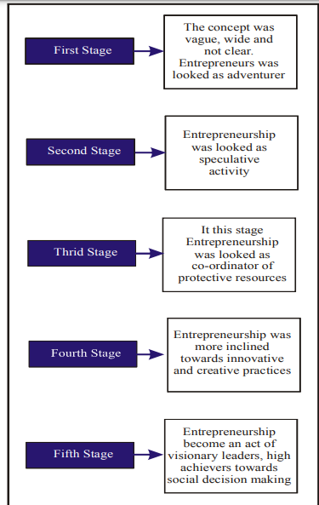
Subject: Entrepreneurship Development & Intellectual Property Rights By : Alok Raj
VIJAYLAXMI AOE0771 Unit 1

Slide 74
Theories Of Entrepreneurship
The different opinions on the emergence of entrepreneurship may be classified into three categories:
A. Economist’s view - Economic incentives are the main drive for the entrepreneurial activities. They firmly believe that a well development market and efficient economic policies foster entrepreneurship a big way.
B. Sociologist’s view - . Sociologists argue that entrepreneurship is most likely to emerge under a specific social culture
C. Psychologist’s view- there are different psychological factors like will to conquer, need for achievement, or withdrawal of status.
Subject: Entrepreneurship Development & Intellectual Property Rights By : Alok Raj
VIJAYLAXMI AOE0771 Unit 1

Slide 75
Theories Of Entrepreneurship
The following theories of entrepreneurship propounded by the different eminent social thinkers:
1. Innovation Theory of Schumpeter
2. Need for Achievement Theory of McClelland
3. Leibenstein’s X-efficiency Theory
4. Risk Bearing Theory of knight.
5. Max Weber’s Theory of Entrepreneurial Growth
6. Hagen’s Theory of Entrepreneurship
7. Thomas Cochran’s Theory of Cultural Values
8. Theory of Change in Group Level Pattern
9. Economic Theory of Entrepreneurship
10. Exposure Theory of Entrepreneurship.
11. Political System Theory for Entrepreneurial Growth.
Subject: Entrepreneurship Development & Intellectual Property Rights By : Alok Raj
VIJAYLAXMI AOE0771 Unit 1

Slide 76
Joseph Schumpeter's Innovation Theory
Joseph Schumpeter's innovation theory of entrepreneurship (1949) holds an entrepreneur as one having three major characteristics: innovation, foresight, and creativity. , The entrepreneur is viewed as the ‘engine of growth’.
Entrepreneurship takes place when the entrepreneur
creates a new product
introduces a new way to make a product
discovers a new market for a product
finds a new source of raw material
finds new way of making things or organization
Subject: Entrepreneurship Development & Intellectual Property Rights By : Alok Raj
VIJAYLAXMI AOE0771 Unit 1

Slide 77
Joseph Schumpeter's Innovation Theory
Schumpeter's innovation theory however ignores the entrepreneur's risk taking ability and organizational skills, and place undue importance on innovation. This theory applies to large-scale businesses, but economic conditions force small entrepreneurs to imitate rather than innovate.
An innovator is more than an inventor because he does not only originate as the inventor does but goes much farther in exploiting the invention commercially.
Subject: Entrepreneurship Development & Intellectual Property Rights By : Alok Raj
VIJAYLAXMI AOE0771 Unit 1

Slide 78
Criticism
i. The theory over emphasized on innovative functions of the entrepreneur. It ignored the organizing aspects of entrepreneurship.
ii. Schumpeter had completely ignored the risk-taking function of the entrepreneur, which cannot be ignored. Whenever an entrepreneur develops a new combination of factors of production, there is enough risk involved.
iii. The theory is more applicable in developed countries only due to paucity of innovative entrepreneurs.
iv. The theory does not provide the explanation as to why few countries have more entrepreneurship talent than others.
Subject: Entrepreneurship Development & Intellectual Property Rights By : Alok Raj
VIJAYLAXMI AOE0771 Unit 1

Slide 79
McClelland's Theory of Achievement Motivation
McClelland's Theory of Achievement Motivation hold that people have three motives for accomplishing things - the need for achievement, need for affiliation, and need for power. Need for achievement and need for power drive entrepreneurship.
Individuals with high achievement orientation are not influenced by considerations of money or any other external incentives. Profit and incentives are merely yardsticks of measurement of success of entrepreneurs with high achievement orientation
David McClelland (1917-1988) considers entrepreneurs as people who do things in a better way and makes decisions in times of uncertainty The dream to achieve big things overpowers monetary or other external incentives.
Subject: Entrepreneurship Development & Intellectual Property Rights By : Alok Raj
VIJAYLAXMI AOE0771 Unit 1

Slide 80
McClelland's Theory of Achievement Motivation
It is the need for achievement (N-Ach), the sense of doing and getting things done, that promote entrepreneurship. McClelland's experiment reveled that traditional beliefs do not inhibit an entrepreneur, and that it is possible to internalize the motivation required for achievement orientation through training
Subject: Entrepreneurship Development & Intellectual Property Rights By : Alok Raj
VIJAYLAXMI AOE0771 Unit 1

Slide 81
Leibenstein’s X-Efficiency Theory
X-efficiency is the degree of inefficiency in the use of resources within the firm: it measures the extent to which the firm fails to realise its productive potential.
According to Leibenstein, When an input is not used effectively the difference between the actual output and the maximum output attributable to that input is a measure of the degree of X-efficiency.
Reason may be resources are used in the wrong way or because they are wasted, that is, not ­used at all. Leibenstein identifies two main roles for the entrepreneur: (i) a gap­filler and (ii) an input completer
Subject: Entrepreneurship Development & Intellectual Property Rights By : Alok Raj
VIJAYLAXMI AOE0771 Unit 1

Slide 82
FRANK KNIGHT’S THEORY OF ENTREPRENEURSHIP
Or Risk Bearing Theory of Knight:
Frank Knight (1885-1972) first introduced the dimension of risk-taking as a central characteristic of entrepreneurship.
He points out that entrepreneurs are a specialized group of persons who bears risk and deal with uncertainty.
This theory considers uncertainty as a factor of production, and holds the main function of the entrepreneur as acting in anticipation of future events.
The entrepreneur earns profit as a reward for taking such risks.
Four important points of this theory are : Risk creates Profit, More Risk More Gain, Profit as Reward , Entrepreneur’s Income is Uncertain.
Subject: Entrepreneurship Development & Intellectual Property Rights By : Alok Raj
Menka Shar AOE0771 Unit 1

Slide 83
Max Weber’s theory of social change
Emphasis on Impact of Religion
Religion, religious beliefs and ethical values play a vital role in determining the entrepreneurial culture.
According to Weber some religions have basic beliefs to earn and acquire money and some have less of it.
Some religions profess the basic rational economic attitude (especially Europe) whereas some religions do not promote materialism (Hinduism).
Capitalism is a fundamental concept (market forces of demand and supply are allowed to play freely) which encourages entrepreneurship
Urge to acquire money and profits
Adventurous spirit and impulsive forces drive entrepreneurs
His theory suggests the belief systems of Hinduism, Buddhism and Islam do not encourage entrepreneurship. Though it was challenged by many sociologists.
Subject: Entrepreneurship Development & Intellectual Property Rights By : Alok Raj
VIJAYLAXMI AOE0771 Unit 1

Slide 84
Criticism
Based on unrealistic and invalid assumptions.
The theory has been found empirically invalid.
Max Weber has been criticized on his view on Hinduism and entrepreneurship. The rapid expansion of entrepreneurship in India in the post-independence period disproves that Hinduism is averse to the spirit of capitalism and to adventurous spirit.
The views on Protestant ethic were also not completely correct. Capitalism has flourished in regions where Protestant ethic is not present.
Subject: Entrepreneurship Development & Intellectual Property Rights By : Alok Raj
VIJAYLAXMI AOE0771 Unit 1

Slide 85
Alfred Marshall's Theory of Entrepreneurship
Alfred Marshall in his Principles of Economics (1890) held land, labor, capital, and organization as the four factors of production, and considered entrepreneurship as the driving factor that brings these four factors together.
The characteristics of a successful entrepreneur include:
thorough understanding of the industry
good leadership skills
foresight on demand and supply changes and the willingness to act on such
risky foresights
• Many economists have modified Marshall's theory to consider the entrepreneur as the fourth factor itself instead of organization, and which coordinates the other three factors.
Subject: Entrepreneurship Development & Intellectual Property Rights By : Alok Raj
Menka Sharma AOE0771 Unit 1

Slide 86
Peter Drucker Theory of Entrepreneurship
Peter Drucker (1909- 2005) defines entrepreneur as one who always searches for change, responds to it and exploits it as an opportunity.
• Innovation is the specific tool of entrepreneurs, the means by which they exploit changes as an opportunity for a different business or a different service
• According to him entrepreneurship involves increase in value or satisfaction to the customer from the resource creation of new values combination of existing materials or resources in a new productive combination.
Innovative entrepreneurship combined with government facilitation.
Subject: Entrepreneurship Development & Intellectual Property Rights By : Alok Raj
VIJAYLAXMI AOE0771 Unit 1

Slide 87
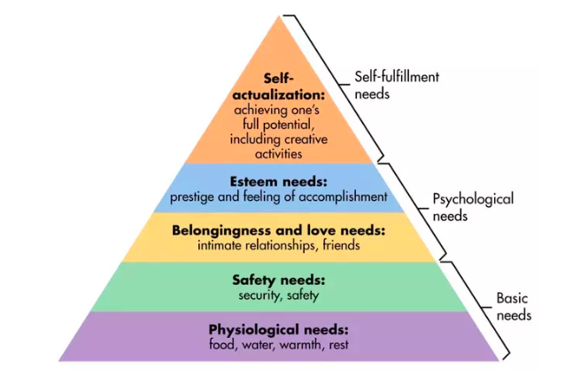
MASLOWS HEIRARCHY OF NEEDS
Subject: Entrepreneurship Development & Intellectual Property Rights By : Alok Raj
VIJAYLAXMI AOE0771 Unit 1

Slide 88
Recap and Quiz
Discuss maslow’s heirarchy of needs.
Define Peter Drucker’s theory of entrepreneurship
Define McClelland’s theory of motivation
Explain Alfred Marshall says about entrepreneurship.
Define entrepreneurship as per Peter Drucker.
Discuss how did Frank Knight express entrepreneurship.
Subject: Entrepreneurship Development & Intellectual Property Rights By : Alok Raj
VIJAYLAXMI AOE0771 Unit 1

Slide 89
Pre-cap
Maslow’s hierarchy of needs.
Peter Drucker’s theory of entrepreneurship
McClelland’s theory of motivation
Alfred Marshall’s thinking about entrepreneurship.
Entrepreneurship as per Peter Drucker.
Frank Knight entrepreneurship.
Subject: Entrepreneurship Development & Intellectual Property Rights By : Alok Raj
VIJAYLAXMI AOE0771 Unit 1

Slide 90
Session objective (CO)
To learn about the qualities of a successful entrepreneur
The reasons for entrepreneurial motivation
Know about Intrapreneurship and corporate entrepreneurship
Subject: Entrepreneurship Development & Intellectual Property Rights By : Alok Raj
VIJAYLAXMI AOE0771 Unit 1

Slide 91
QUALITIES OF A SUCCESSFUL ENTREPRENEUR
Full of determination
Risk taking
High level of confidence
Learner
Understands failure is part of the game
Passionate
Adaptability and flexibility
Money management
Networking abilities
Tolerance for failure and ambiguity
Subject: Entrepreneurship Development & Intellectual Property Rights By : Alok Raj
VIJAYLAXMI AOE0771 Unit 1

Slide 92
ENTREPRENEURIAL MOTIVATION
The word motivation has been derived from the word “motive”. Motive may be defined as an inner state of our mind that moves or activates or energise and directs our behaviour towards our goal.
Motivation is a drive to achieve a target.
Motives are the expression of a person’s goal or needs.
Subject: Entrepreneurship Development & Intellectual Property Rights By : Alok Raj
VIJAYLAXMI AOE0771 Unit 1

Slide 93
MOTIVATING FACTORS
INTERNAL FACTORS
Desire To Do Something
Educational Background
Experience
EXTERNAL FACTORS
Government Assistance And Support
Availability Of Raw Material
Encouragement From Big Businesses Houses
Promising Demand For The Product.
Subject: Entrepreneurship Development & Intellectual Property Rights By : Alok Raj
VIJAYLAXMI AOE0771 Unit 1

Slide 94
Corporate Entrepreneurship
Corporate entrepreneurship
We define the term as the procedure by which teams within an established company conceive, foster, launch and manage a new business separate from the parent company but leverage the parent’s properties, market position, competencies or other resources.
This process seeks to create value, drive revenue growth, and encourage innovation inside the company through entrepreneurial thoughts and actions.
Subject: Entrepreneurship Development & Intellectual Property Rights By : Alok Raj
VIJAYLAXMI AOE0771 Unit 1

Slide 95
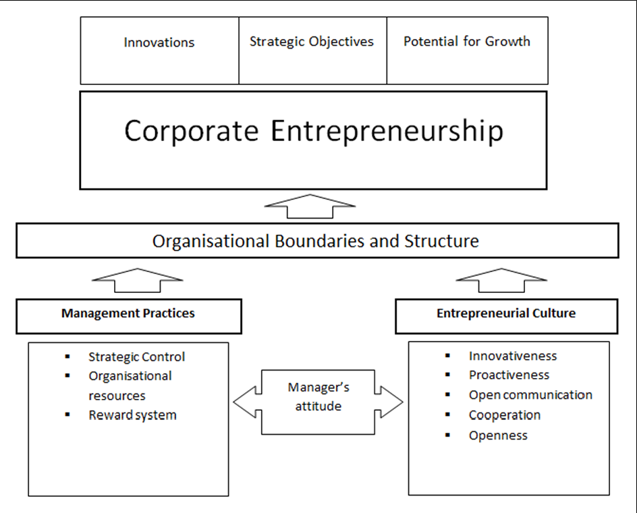
Corporate Entrepreneurship
Subject: Entrepreneurship Development & Intellectual Property Rights By : Alok Raj
VIJAYLAXMI AOE0771 Unit 1

Slide 96
Corporate Entrepreneurship
The Importance of Corporate Entrepreneurship
Drives Revenue and Organizational Growth
Boosts Employee Morale and Productivity
Increases Employee Recruitment and Retention
Subject: Entrepreneurship Development & Intellectual Property Rights By : Alok Raj
VIJAYLAXMI AOE0771 Unit 1

Slide 97
INTRAPRENEURS
Intrapreneurs are self-motivated, proactive, and action-oriented people who take the initiative to pursue an innovative product or service.
An intrapreneur knows failure does not have a personal cost as it does for an entrepreneur since the organization absorbs losses that arise from failure. Intrapreneurship is one step toward entrepreneurship—intrapreneurs can use what they've learned as part of a team to develop their own businesses.
Intrapreneurs are employees who are generally self-starters who are both ambitious and goal oriented. They are often able to solve problems on their own, and come up with ideas that lead to process improvements. An intrapreneur may also take certain risks by assuming multiple tasks—even some that they may not be comfortable with—and look for new challenges.
Subject: Entrepreneurship Development & Intellectual Property Rights By : Alok Raj
VIJAYLAXMI AOE0771 Unit 1

Slide 98
Corporate entrepreneurship
Intra-preneur is a manager who focuses on innovation and creativity, who brainstorms, dreams and puts ideas into profitable venture by operating within the organizational environment.
It gives managers the freedom to try new ideas by employing firm’s resources in a unique way.
Some examples
Google ,
3M- has established its reputation as a powerhouse of innovation. This is because they have developed more than 60,000 products in their portfolio, ranging from the products used in medical equipment to the automobile industry,
P&G
Subject: Entrepreneurship Development & Intellectual Property Rights By : Alok Raj
VIJAYLAXMI AOE0771 Unit 1

Slide 99
Video Link
https://www.youtube.com/watch?v=p7vhcob-YkI&list=PLbRMhDVUMngcukfJf-ChqlbjZzthAbRPw&index=2
https://www.youtube.com/watch?v=Y8D3QYqzb80&list=PLbRMhDVUMngcukfJf-ChqlbjZzthAbRPw&index=3
https://www.youtube.com/watch?v=CF27N7DgfXc&list=PLbRMhDVUMngcukfJf-ChqlbjZzthAbRPw&index=4
https://www.youtube.com/watch?v=Q_KY8zWPKpE&list=PLbRMhDVUMngcukfJf-ChqlbjZzthAbRPw&index=5
Subject: Entrepreneurship Development & Intellectual Property Rights By : Alok Raj
VIJAYLAXMI AOE0771 Unit 1

Slide 100
Daily Quiz
An individual who starts, creates and manages a new business can be called _____________.
A. A leader
B. A manager
C. A professional
D. An entrepreneur
2. Which could provide an individual with the motivation to start a new business venture?
A. The financial rewards.
B. A desire to be independent.
C. Risk taking
D. All the above.
Subject: Entrepreneurship Development & Intellectual Property Rights By : Alok Raj
VIJAYLAXMI AOE0771 Unit 1

Slide 101
Quiz
3. Trademarks relate to _______.
A. Practice and knowledge acquired through experience
B. The protection of proprietary information of commercial value
C. The right to reproduce ones own original work
D. Brand identity
4. Which of the following factors should not be included in PESTLE analysis?
A. Government re-cycling policy.
B. Proposed reduction in interest rates.
C. Competitor activity.
D. Demographic changes.
Subject: Entrepreneurship Development & Intellectual Property Rights By : Alok Raj
VIJAYLAXMI AOE0771 Unit 1

Slide 102
Quiz
5. Which of the following shows the process of creating something new?
Business model
Modeling
Creative flexibility
Innovation
6. What is the process by which individuals pursue opportunities without regard to resources they currently control?
Startup management
Entrepreneurship
Financial analysis
Feasibility planning
Subject: Entrepreneurship Development & Intellectual Property Rights By : Alok Raj
VIJAYLAXMI AOE0771 Unit 1

Slide 103
MCQs
1. A person who managed large project was termed as the entrepreneur in the _________.
a) Earliest period
b) Middle ages
c) 17th century
d) 19th and 20th century .
2. Which of the following factors is the most important in forcing companies to focus on new product development and increased productivity?
a) Entrepreneurship
b) Hyper competition
Governmental laws
Organizational culture
Subject: Entrepreneurship Development & Intellectual Property Rights By : Alok Raj
VIJAYLAXMI AOE0771 Unit 1

Slide 104
MCQs
3. An entrepreneur who is the owner of more than one business is called:
Portfolio Entrepreneur
Intrapreneur
Corporate Entrepreneur
None of the above
4. Which of the following is alternatively called corporate venturing?
a) Entrepreneurship
b) Intrapreneurship
c) Act of stating a new venture
d) Offering new products by an existing company
Subject: Entrepreneurship Development & Intellectual Property Rights By : Alok Raj
VIJAYLAXMI AOE0771 Unit 1

Slide 105
MCQs
5. Individuals influencing an entrepreneur’s career choice and style are known as which of the following?
a) Moral-support network
b) Role model
Professional support network
Support system
6. According to Schumpeter, innovative entrepreneurs would:
Thrive in the market
Not survive and disappear from the market.
Get absorbed within larger innovative businesses
Get absorbed within non-innovative businesses
Subject: Entrepreneurship Development & Intellectual Property Rights By : Alok Raj
VIJAYLAXMI AOE0771 Unit 1

Slide 106
MCQs
7. The activity which occurs when the new venture is started is called:
a) Motivation
Business skills
Departure point
Goal orientation
8. The level at which an individual is viewed by society is called:
Financial status
Qualification
Social status
Achievement
Subject: Entrepreneurship Development & Intellectual Property Rights By : Alok Raj
Menka Sharma AOE0771 Unit 1

Slide 107
MCQs
9. Which one of the following is the most important characteristic of a successful business website?
a) Innovation
b) Speed
Graphics
Products
10. Why should an entrepreneur do a feasibility study for starting a new venture
a) To identify possible sources of funds
To see if there are possible barriers to success
To estimate the expected sales
To explore potential customers
Subject: Entrepreneurship Development & Intellectual Property Rights By : Alok Raj
Menka Sharma AOE0771 Unit 1

Slide 108
Assignment
“ Entrepreneurship is the process of creating wealth.” Explain
What is the importance of entrepreneurship in a developing country like india?
“Entrepreneurs are agents of change”. How do entrepreneurs bring about such a change?
What is entrepreneurship? Discuss the various types of entrepreneurs?
Subject: Entrepreneurship Development & Intellectual Property Rights By : Alok Raj

Slide 109
Old Question Papers link
http://www.aktuonline.com/papers/mba-4-sem-entrepreneurship-development-rmb-402-2017-18.pdf
https://www.uptunotes.com/aktu-uptu-entrepreneurship-development-mam401a-previous-year-question-paper/
https://abesit.in/library/download/MBA/Sem.3/2016-17/ENTREPRENEURSHIP-DEVELOPMENT-NMBA-031MBTM-031.pdf
Subject: Entrepreneurship Development & Intellectual Property Rights By : Alok Raj
VIJAYLAXMI AOE0771 Unit 1

Slide 110
Expected Question Papers
Define the term Entrepreneur & Intrapreneur, explain the attributes of a successful entrepreneur?
Illustrate the role of entrepreneurship in Indian Economy.
Explain the prospects of women entrepreneurship in India
Subject: Entrepreneurship Development & Intellectual Property Rights By : Alok Raj
VIJAYLAXMI AOE0771 Unit 1

Slide 111
Summary
Meaning, definition and concept of entrepreneur, entrepreneurship and entrepreneurship development.
Theories of entreprneurship
Role of entrepreneurship in economic development.
Concepts of intrapreneurship, types of entrepreneurs,
Subject: Entrepreneurship Development & Intellectual Property Rights By : Alok Raj
VIJAYLAXMI AOE0771 Unit 1

Slide 112
References
1. Roy :Entrepreneurship, OUP
2. Entrepreneurship 10th Ed (Indian Edition) 2016 by Robert Hisrich Michael Peters Dean Shepherd, McGraw Hill
3. Khanka, S.S.; Entrepreneurial Development; S. Chand and Co.
4. Kumar, Arya; Entrepreneurship; Pearson Education.
5.Desai, Vasant; Dynamics of Entrepreneurial Development and Management; Himalaya Publishing
6. Blundel, R. and Lockett, N.; Exploring Entrepreneurship Practices and Perspectives; Oxford Publications.
7. Dollinger, M. J.; Entrepreneurship: New Venture Creation; PHI Learning.
Subject: Entrepreneurship Development & Intellectual Property Rights By : Alok Raj
VIJAYLAXMI AOE0771 Unit 1

Slide 113
Thank You
Subject: Entrepreneurship Development & Intellectual Property Rights By : Alok Raj
VIJAYLAXMI AOE0771 Unit 1

